Slide 1
CIS Devsecops Team
Webhooks for Bit Bucket
October 2019
Notes:
Thanks Everyone for joining.
Lets move on into The agenda for today

Slide 2
Agenda ____________________________________
Description
Configuraton
Features
Q&A
Notes:
Today we’ll review some aspects about the AppScan Tool, the project and our goal as Dev Sec Ops Team

Slide 3
Description
Webhooks provide a way to configure Bitbucket Server to make requests to your server , whenever certain events occurs in a repository.
Ex: When code is pushed or a pull request is merged.
Easily configure your hook on a project level or repository level.
Test your configuration with a click of a button (Trigger jenkins)
Add multiple Jenkins servers , ignore commits from specific users.

Slide 4
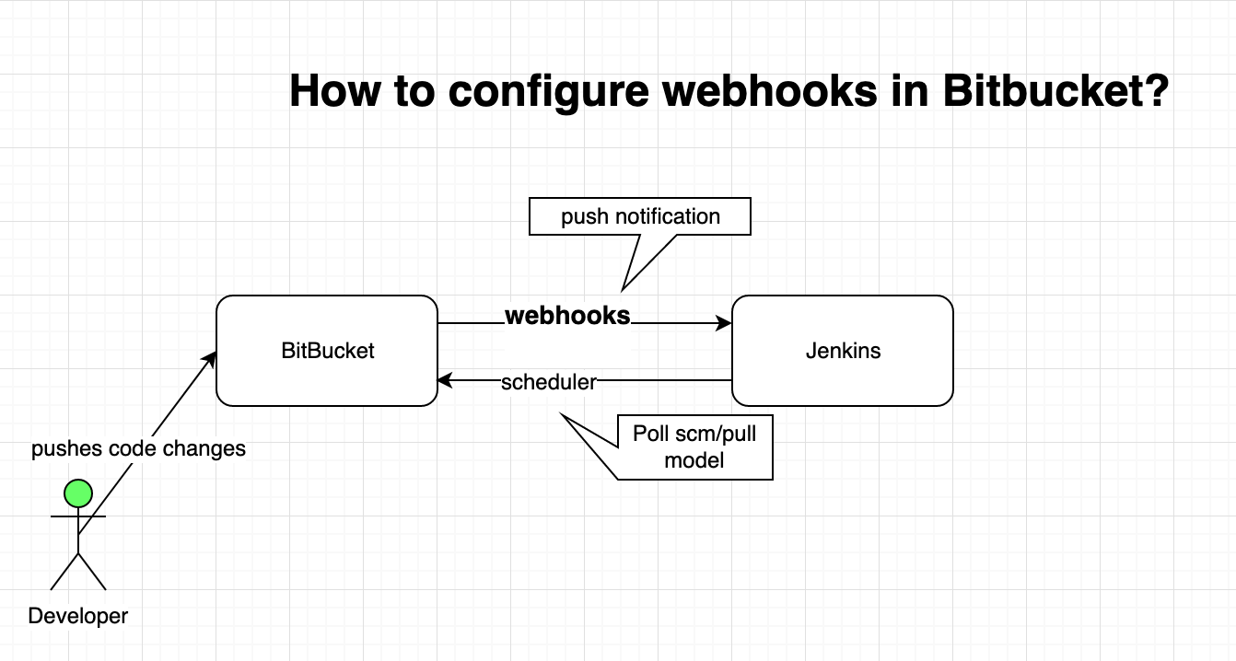
Configuration

Slide 5
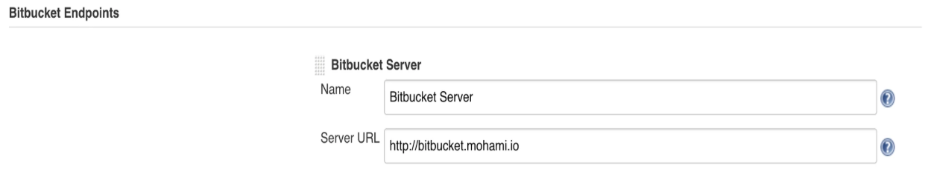
There is a little Configuration required in both Jenkins and Bitbucket.
Configuring Jenkins
Install the Bitbucket Branch Source plugin in Jenkins.
Manage Jenkins
Configure system
Bitbucket end point

Slide 6
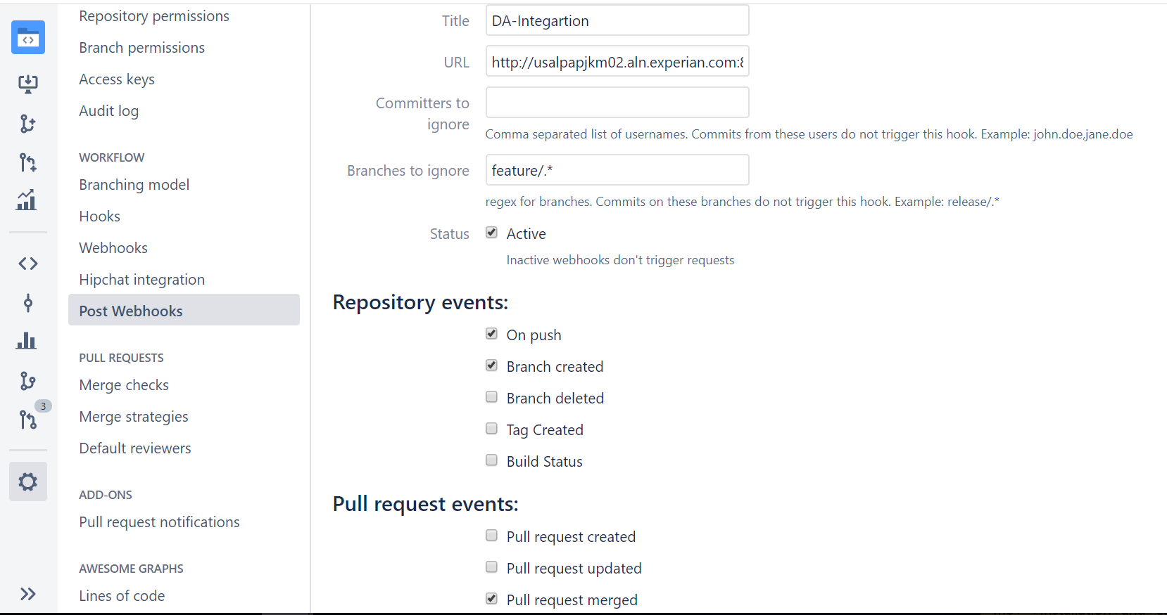
Configuring Webhooks

Slide 7
Features
Support for project/repository level configuration.
Support for adding multiple Jenkins servers.
Support for build parameters.
Easily test your configuration on the hook settings screen.
Ability to retrigger builds manually from the pull request screen.
Highly configurable.
Ignore certain commits or branches.

Slide 8

Questions?

